Slide 1
Python project
By : parth Mahajan
B.Tech cse
Section-b
130020203053

Slide 2
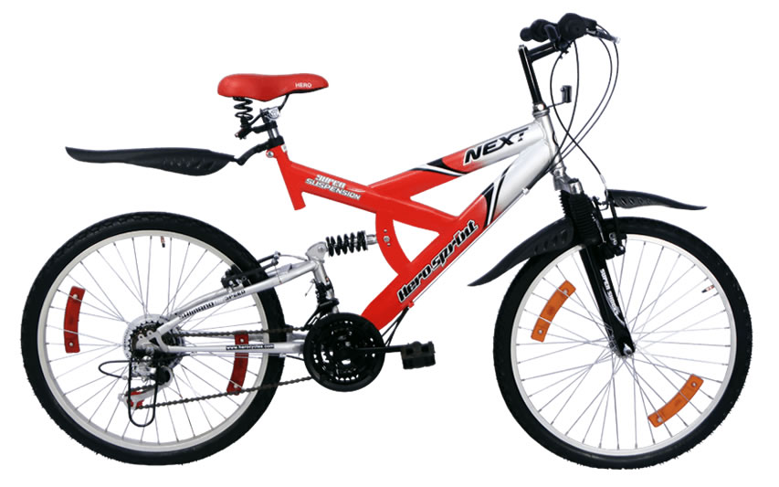
New Hero sports bike
Hero has designed a new style of sports bicycle Hero Octane DBT ! Now Hero want to make lots of them and sell them for profit.

Slide 3
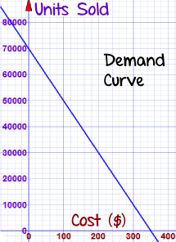
Problem:
>>Our costs are going to be:
$700,000 for manufacturing set-up costs, advertising, etc.
$110 to make each bike
Based on similar bikes, you can expect sales to follow this "Demand Curve":
Unit Sales = 70,000 - 200P
Where "P" is the price.
>>For example, if we set the price:
at $0, you would just give away 70,000 bikes
at $350, you would not sell any bikes at all.
at $300 you might sell 70,000 - 200×300 = 10,000 bikes
So ... what is the best price? And how many should you make?

Slide 4
Aim And Requirements
Aim : To maximize the profit on bicycle.
Language : Python
Package Required : Scipy.optimize , matplotlib.pylab and numpy
Optimizer Required : minimize_scalar()
IDE Required : ipython notebook by Jyupter

Slide 5
Solution:
Let us make some equations!
How many you sell depends on price, so use "P" for Price as the variable
Unit Sales = 70,000 - 200P
Sales in Dollars = Units × Price = (70,000 - 200P) × P = 70,000P - 200P²
Costs = 700,000 + 110 x (70,000 - 200P) = 700,000 + 7,700,000 - 22,000P = 8,400,000 - 22,000P
Profit = Sales-Costs = 70,000P - 200P² - (8,400,000 - 22,000P) = -200P² + 92,000P - 8,400,000
Profit = -200P² + 92,000P - 8,400,000

Slide 6
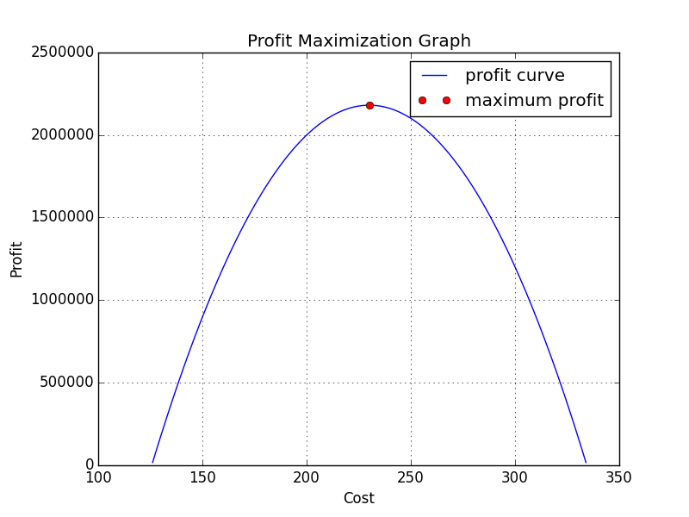
Python code:
import matplotlib.pylab as plt
import scipy.optimize as opt
import numpy as np
obj=np.poly1d([-200,92000,-8400000])
print obj
result=opt.minimize_scalar(-obj,[-10,10])
print result.x
print result.fun
y1=np.linspace(126,334,100)
plt.plot(y1,obj(y1),label='profit curve')
plt.plot(result.x,-result.fun,'ro',label='maximum profit')
plt.xlabel("Cost")
plt.ylabel("Profit")
plt.title("Profit Maximization Graph")
plt.legend()
plt.grid()
plt.show()

Slide 7
Optimization report:
Function Value (Maximum Profit) : 2180000.0
Function Evaluations : 5
Net Iterations : 4
Value of x (cost for maximum profit) : 230.00000000000011

Slide 8
Result:
Unit Sales = 70,000 - 200 x 230 = 24,000
Sales in Dollars = $230 x 24,000 = $5,520,000
Costs = 700,000 + $110 x 24,000 = $3,340,000
Profit = $5,520,000 - $3,340,000 = $2,180,000
A very profitable venture.

Slide 9
Thank you !! Happy programming ☺

